Slide 1

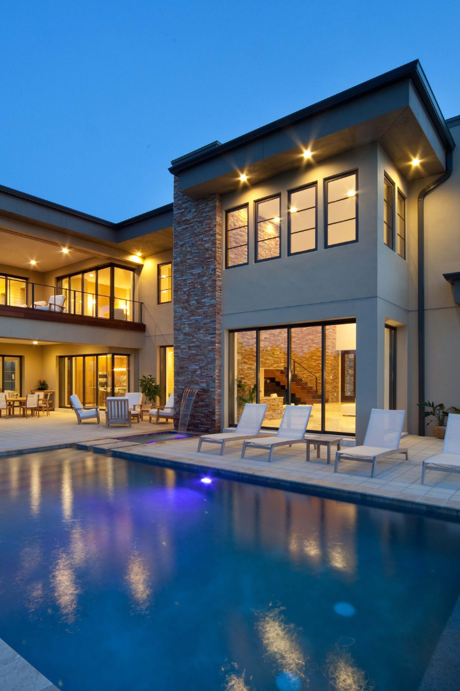
Predicting House Prices Using Machine Learning
By
Aishwarya. R
Annie Margaret. A
Bebin Sherina. F. R
Daiyana. R
Deepika Sree A .M
Devadharshini. C
III YEAR CSE Department
St. Joseph College of Engineering

Slide 2
Introduction
Over long ago, there is manually decide the price of any property. But problem is that in manually there are 25% percent error is occurred and such affect is loss of money. But now there is big change by changing the old technology. Today’s Machine Learning is trending technology. Data is the heart of Machine Learning. Nowadays the booming of AI and Machine Learning in market. All industry are move towards automation. But without data we can’t train model. Basically in Machine Learning involves building these model from previous data and by using them to predict new data. The market demand for housing is increases daily because our population is rising rapidly.in rural area there is lack of jobs due to this public is migrating for financial purpose.so result is increasing demand of housing in cities. People who don’t know the actual price of that particular house and they suffer loss of money. In this project, the house price prediction of the house is done using different Machine Learning algorithms like Leaner Regression, Decision Tree Regression, K- Means Regression and Random Forest Regression. 80% of data form kwon dataset is used for training purpose and remaining 20% of data used for testing purpose. This work applies various techniques such as features, labels, reduction techniques and transformation techniques such as attribute combinations, set missing attributes as well as looking for new correlations. This all indicates that house price prediction is an emerging research area and it requires the knowledge of machine learning.

Slide 3
Literature Survey
In this conference paper we have to analyse the different Machine Learning algorithms for better training Machine Learning model. Trends in housing cost show the current economic situation and as well as to directly concern with buyers and sellers. Actual cost of house is depending on so many factors. They include like no of bedrooms, number of bathrooms,and location as well.in rural area cost is low as compare to city. The house price grate with like near to highway, mall, super market, job opportunities, good educational facilities etc. Over few years ago, the real estate companies trying to predict price of property by manually. In company there is special management team is present for prediction of cost of any real estate property. They are decide price manually by analysing previous data. But there 25% of error is occurred on that prediction.so there is loss of buyers as well as sellers. Hence there are many systems are developed for house price prediction. Sifei Lu, Rick Siow had proposed advance house prediction system. The main objective of this system’s was to make a model which give us a good house price prediction based on other features.

Slide 4
Proposed System
In this proposed system, we focus on predicting house price using machine learning algorithms like Leaner Regression, Decision Tree, k-Means, and Random Forest. We proposed the system “House Price Prediction Using Machine Learning” we have predict the house price using multiple features. In this proposed system, we are able to train model from various features like ZN, INDUS, CHAS, RAD etc. the previous data taken and out of this 80% of data is used for training purpose and remaining 20% of data used for testing purpose. Hare, the raw data is stored in‘.csv’ file. We are majorly used two machine learning libraries to solve these problems. The first one was ‘pandas’ and another one is ‘numpy’. The pandas used for to load ‘.csv’ file into Jupiter notebook and also used to clean the data as well as manipulate the data. Another was sklearner, which was used for real analysis and it has containing various inbuilt functions which help to solve the problem.one more library was used which is nothing but numpy. For the purpose of train-test splitting numpy was used.

Slide 5
SYSTEM DESIGN AND ARCHITECTURE
1
Phase I: Collection of data
We are collected data for real estate from different online real estate websites and repository. In such data have features like ‘ZN’, ‘INDUS’, ‘RAD’,‘CHAS’,‘LSTAT’,‘CRIM’,‘AGE’,‘NOX ’etc. and one label is ‘MEDV’. We must collect the data which is well structured. When we start to solve any machine learning problem first data is must require.
Phase II: Data Pre- Processing
2
In this phase, our data is clean up. There is might be missing values in our dataset. There are three ways to fill our missing values:
3
Phase III: Training the model
In this phase, data in broken down into two part: Training and Testing. There are 80% of data is used for training purpose and reaming 20% used for testing purpose. The training set include target variable.
Phase IV: Testing the model
4
Finally, the trained model is applied to test dataset and house price predicted.

Slide 6

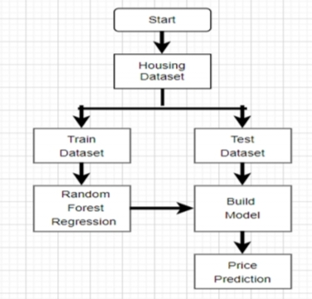
The generic flow of development

Slide 7

Methodology
I. Algorithms: In the process of developing this model, various machine learning algorithms were studied. The model is trained on Leaner regression, Decision tree, K-mean and Random forest algorithms. Out of this Random Forest give a highest accuracy in prediction of housing prices. The decision to choose the algorithm is depends on the dimensions and type of data is used. Random Forest is best fit for our model.
II. Random Forest Regressor: The random forest regressor observes features of an attribute and train the model by analysing given features. Random Forest regressor from the graph, attribute combination, labels including features and according to system analyses the data.

Slide 8
Implementation
1
Phase 1: Data Processing
In this phase, the missing attribute is handle by using mean value. The target is feature is drop out. By using Pandas library the operation is performed. For visualization of dataset graph use Matplotlib python function. After that try to catch some attribute combination and set the missing values.
Phase 2: Looking for Correlations
2
We are trying to find out some new correlation between various attribute. This correlation gives either strong positive correlation with our label or gives strong negative correlation. Find out some new correlations Here, show the data point of new attribute‘TAXRM’
3
Phase 3: Filling Missing Attributes
In above data, the ‘RM’ column have total 399 data point out of 404.some data point are missing. To use value of median to set missing points. After setting missing point ‘RM’ column has all total 404 data points are fulfil. After that, creating a pipeline for the execution.
Phase 4: Fitting the Model
4
From the Sklearn library, a Random forest regressor is used to train a model.

Slide 9
Result
To use various machine learning algorithms for solving this problem. Out of that the Random forest is predict better accuracy than other models.

Slide 10
Conclusion
The paper entitled “House Price Prediction Using Machine Learning” has presented to predict house price based on various features on given data. From our analysis we set value of RMSE as 2.9131889. In this model we have to add additional features like tax, air quality so it become different from other prediction system. It helps people to buy house in budget and reduce loss of money

